Slide 1
Software Process Models

Slide 2
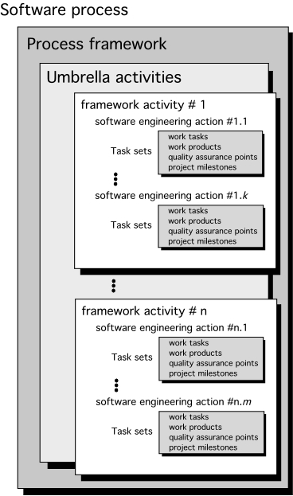

Slide 3
Identifying a Task Set
A task set defines the actual work to be done to accomplish the objectives of a software engineering action.
A list of the task to be accomplished
A list of the work products to be produced
A list of the quality assurance filters to be applied

Slide 4
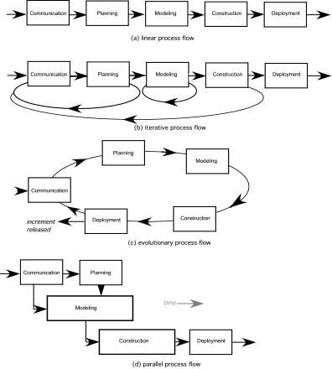

Slide 5
Phases of Software Process Model
Requirements phase
Specification phase
Design phase
Implementation phase
Integration phase
Maintenance phase
Retirement

Slide 6
Requirement
Definition
Waterfall Model
System and
Software Design
Implementation
and Unit Testing
Integration and
System Testing
Operation and
Maintenance

Slide 7
Requirement
Definition
Waterfall Model
System and
Software Design
Implementation
and Unit Testing
Integration and
System Testing
Operation and
Maintenance

Slide 8
Rapid
Prototyping
Rapid Prototyping Model
Requirement
Definition
System and
Software Design
Implementation
and Unit Testing
Integration and
System Testing
Operation and
Maintenance

Slide 9
Build and Fix Model
Build first
version
Modify until
client is satisfied
Maintenance
phase
Development
Maintenance
Retirement

Slide 10
Incremental Model
Requirements phase
Verify
Specification phase
Verify
Architectural design
Verify
For each build:
Perform detailed design, implementation and integration,
test, deliver to client
Maintenance phase
Development
Retirement
Maintenance

Slide 11
Incremental Model (cont.)
Build 1
Specification
Design
Implementation, integration
Deliver to client
Build 2
Specification
Design
Implementation, integration
Deliver to client
Build 3
Specification
Design
Implementation, integration
Deliver to client
Build n
Specification
Design
Implementation, integration
Deliver to client
Specification team
Implementation, integration team
Design team

Slide 12
Simplified Spiral Model
Risk Analysis
If risks cannot be resolved, project is immediately terminated
Rapid Prototype
Specification
Design
Implementation
Verify
Integration

Slide 13
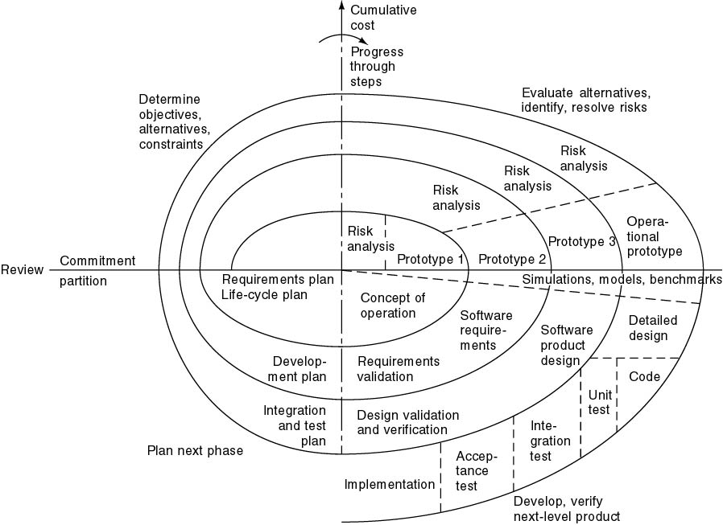
Full Spiral Model
Angular dimension (progress)
Radial dimension (cost)

Slide 14
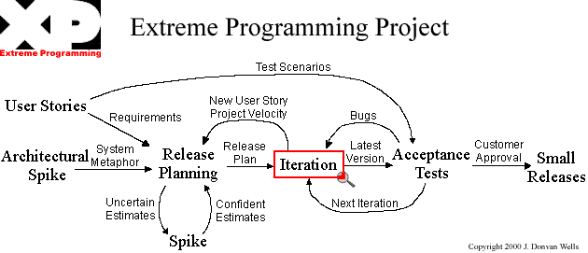
Extreme Programming

Slide 15
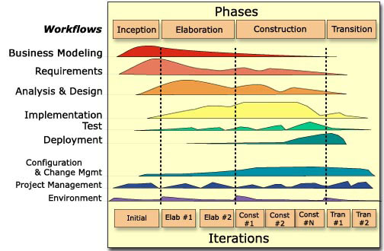
Rational Unified Process
(this Figure is from P. Krutchen’s paper)

Slide 16
Documentation Phase?
There is NO documentation phase
Every phase must be fully documented before starting the next phase
Postponed documentation may never be completed
The responsible individual may leave
The product is constantly changing—we need the documentation to do this
The design (for example) will be modified during development, but the original designers may not be available to document it

Slide 17
Phase | Documents | QA
Requirement Definition | Rapid prototype, or Requirements document | Rapid prototype Reviews
Functional Specification | Specification document (specifications) Software Product Management Plan | Traceability FS Review
Design | Architectural Design Detailed Design | Traceability Review
Coding | Source code Test cases | Traceability Review Testing
Integration | Source code Test cases | Integration testing Acceptance testing
Maintenance | Change record Regression test cases | Regression testing

Slide 18
Traceability matrix
Requirement ID | Use Case ID | UID | Class/ function | Test Case ID

